Slide 1

Diogo Silva, 98776
DDJ 1st Assignment – “Game of your Life”
IST 2021/2022

Slide 2

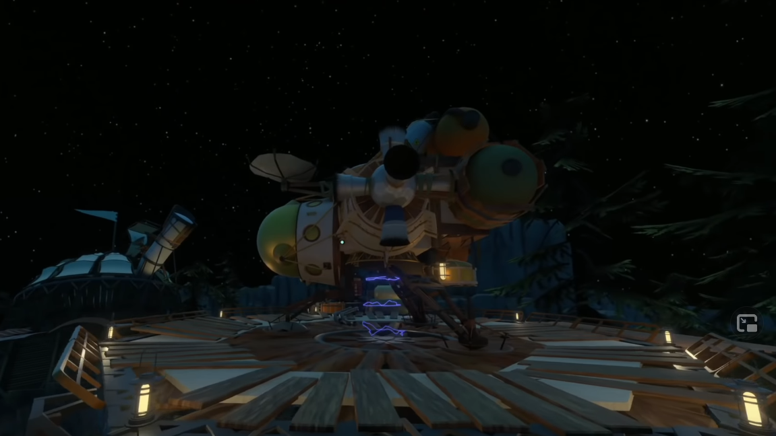
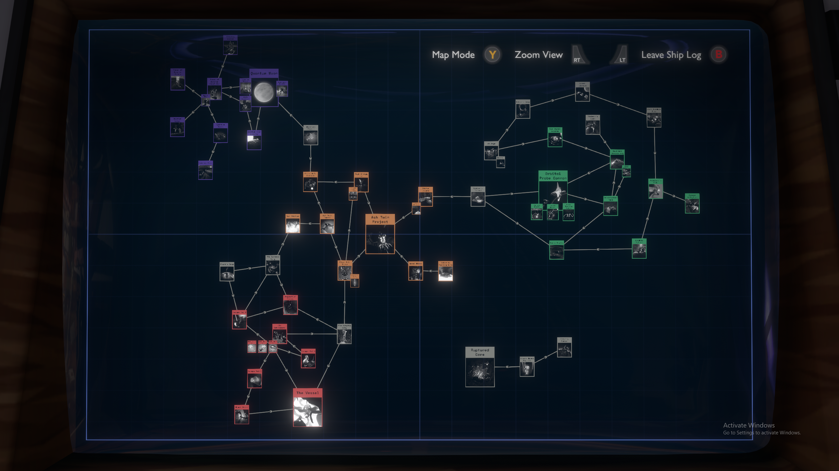
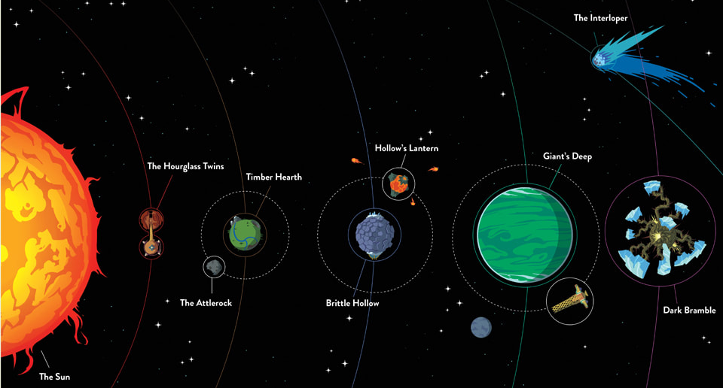
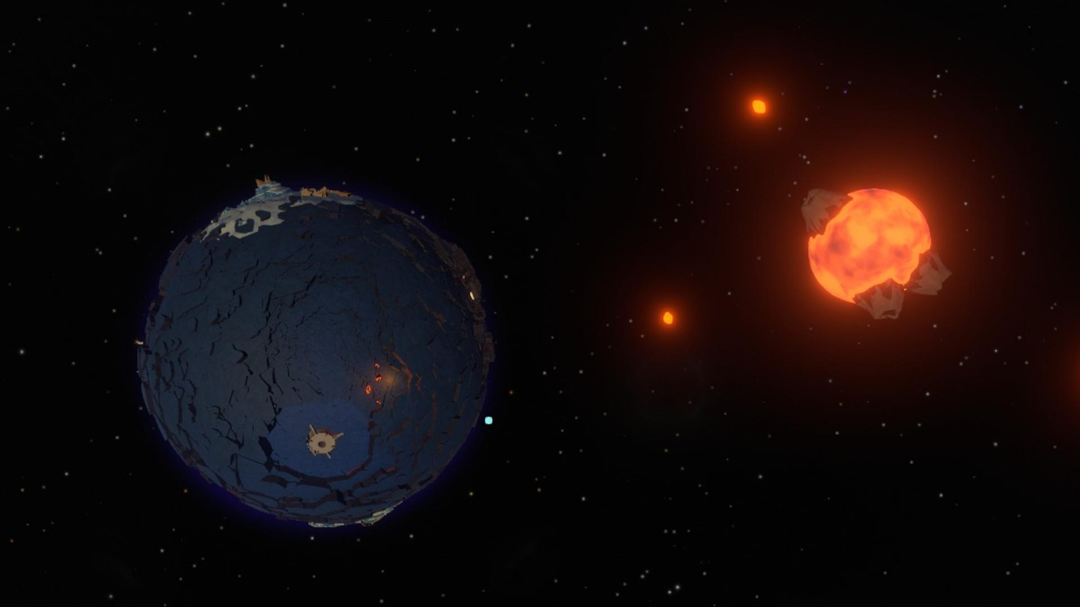
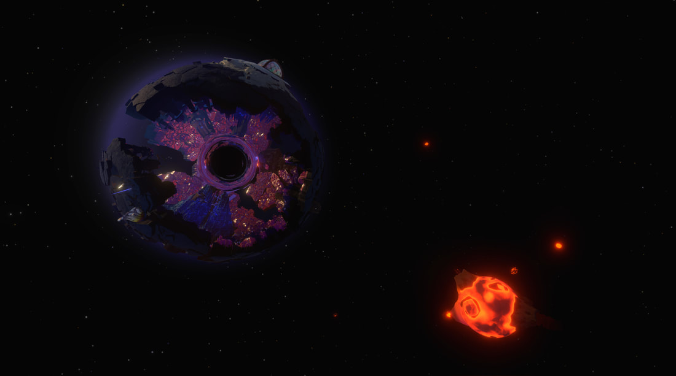
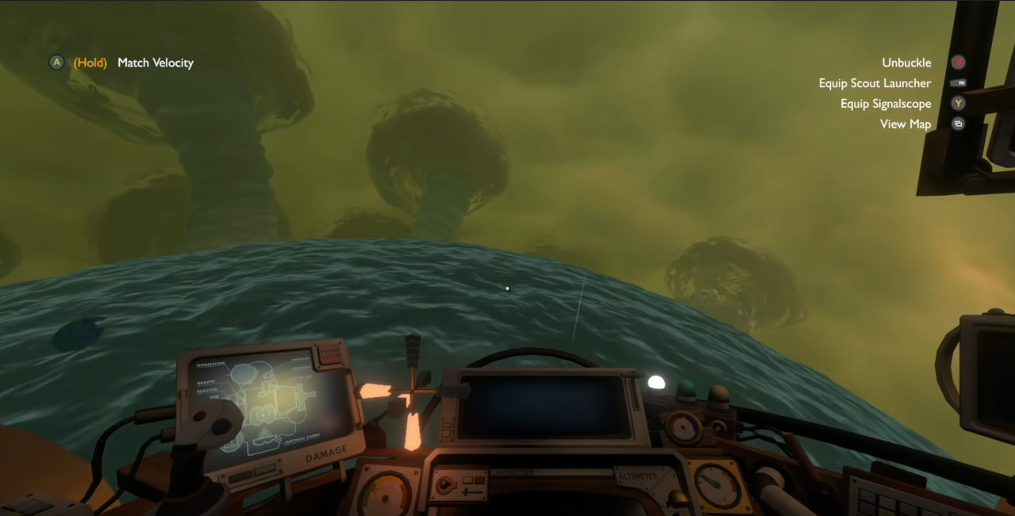

Slide 3


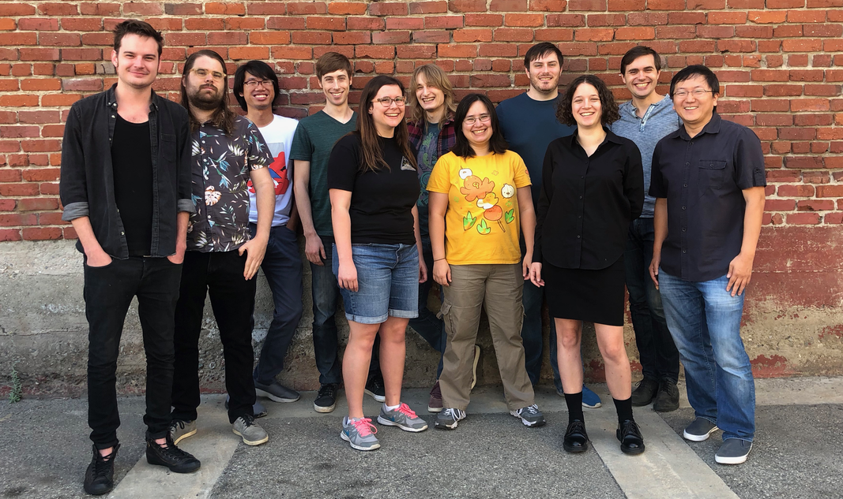

Slide 4



Slide 5
Astonishing Design & Technical Achievement
Unique Non-Linear Storyline
New Perspective on Life!

Slide 6


